Slide 1
Data Discovery using MySQL Workbench
In this presentation I will be showing what kind of data is available to us for visualization, the different tables, columns in each tables etc.
I have imported the data from a sql dump file into the MySQL workbench and we are ready for querying.
- Harsh Kondkar

Slide 2
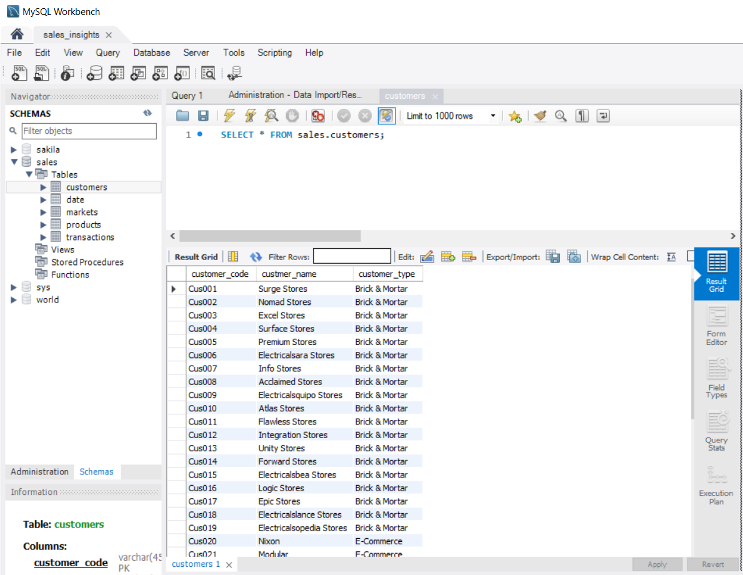
In the ‘SCHEMAS’ pane we can see the tables that are available under the ‘sales’ schema:
customers
date
products
transactions
We run our first query to select all the data available in the ‘customers’ table.
We see that this table has three columns:
customer_code
customer_name
customer_type

Slide 3
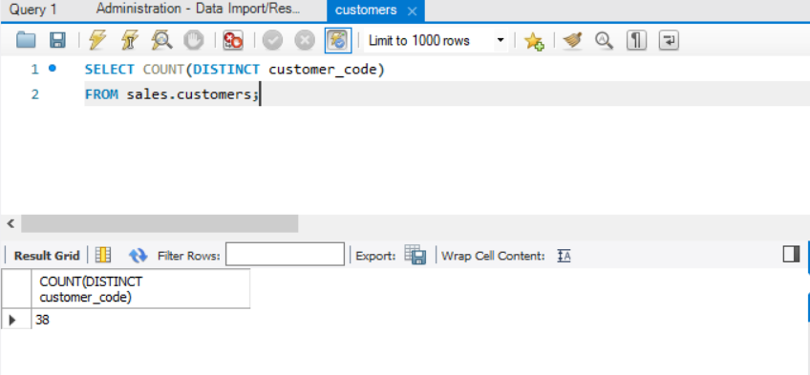
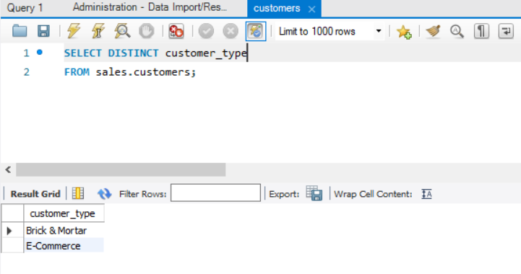
This query returns the total number of customers the company has.(38)
It gives us an idea of how vast the business is.
Using this query we realize that the company is providing to only two types of customers:
Brick & Mortar
E-Commerce

Slide 4
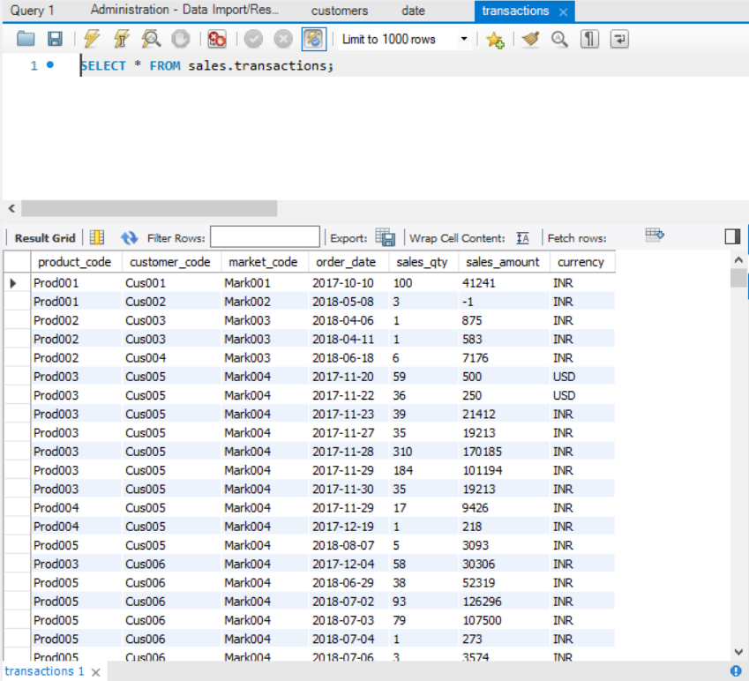
This is an overview of the transactions table which includes,
a) the product_code of sent item,
b) the customer_code of receiving party,
c) the market_code, the date on which the order was placed,
d) quantity of order placed
e) total amount received
f) the currency in which the payment was made.

Slide 5
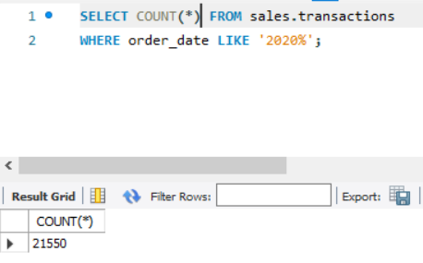
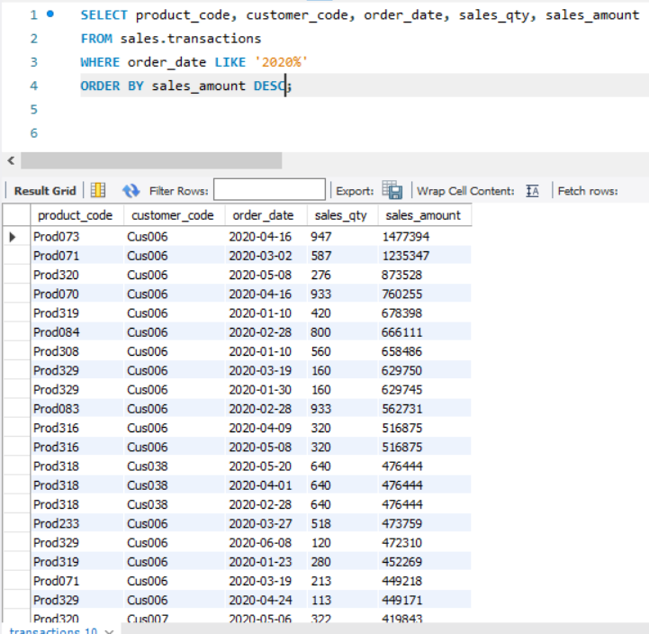
This query gives us the total number of transactions in the year 2020.
This gives us the transaction data for the year 2020 in order of highest to lowest sales amount.
We can also query to get the data for a particular date by just making a few changes.

Slide 6
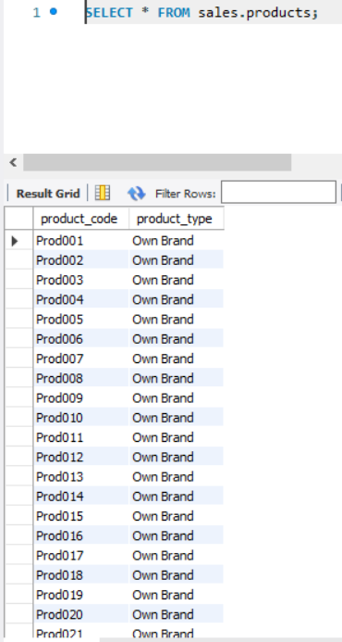
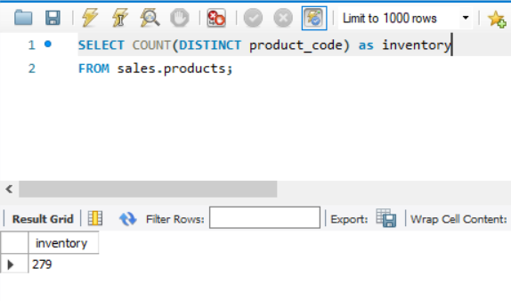
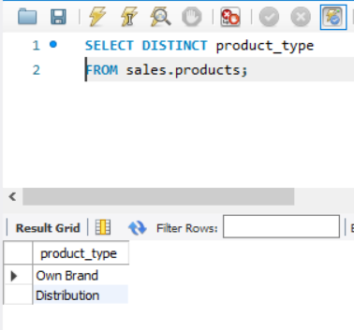
This is an overview of the products table which tells us about the type of product and its code.
We see that there are only two types of products the company provides and the total inventory of the company

Slide 7
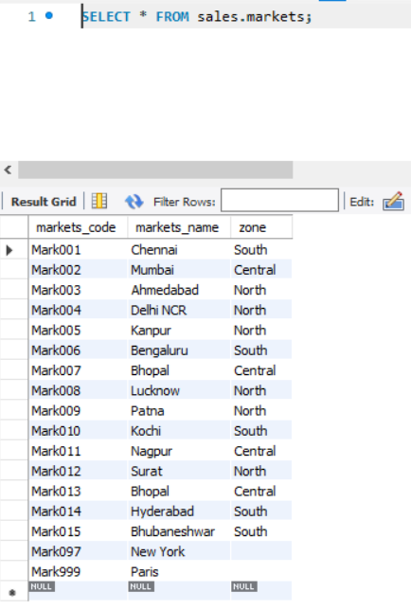
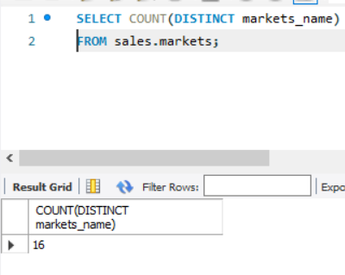
The market table gives us an idea of in which cities does the company supply its products
We see that the company provides to 16 different location all over the country.
Now we have a basic idea of what our data looks like and what each table and their respective columns represent.
Next we will go into Tableau and do some data visualization to derive some sales insights.

